Slide 1

Quant Week 8
4/4/24
Notes:
Complete

Slide 2

Agenda
Icebreaker Question
Brainteasers
Project

Slide 3
Ice Breaker
If an alligator with wings got into a battle with a great white shark with a jet pack, who would win?

Slide 4


IMC Sponsorship!
Referal Code: 3MRLW8

Slide 5
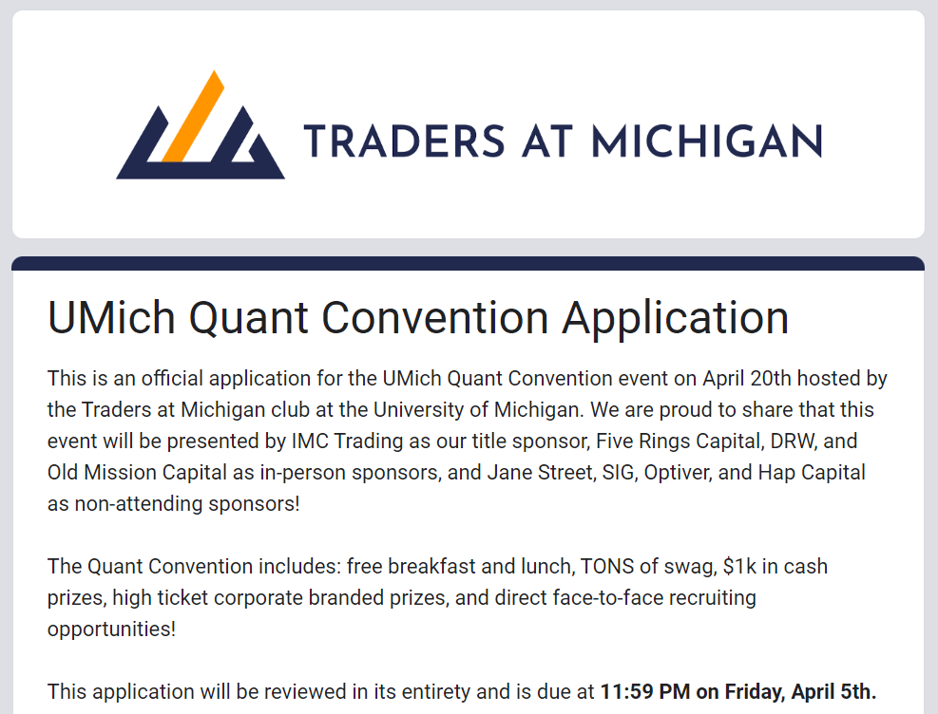
Quant Conference
https://docs.google.com/forms/d/e/1FAIpQLScZRTzsPrafhUgLAJVF5GTdyxekcqPIVC9TeYD-JrGRv0M0UQ/viewform
April 5th!

Slide 6
IMC Sponsorship!
Sophomores, apply to IMC Launchpad:
https://careers.imc.com/us/en/launchpad
Great opportunity to learn
If you get in, IMC gives you a final round internship interview
IMC Event
April 16th 6pm/Date TBD

Slide 7
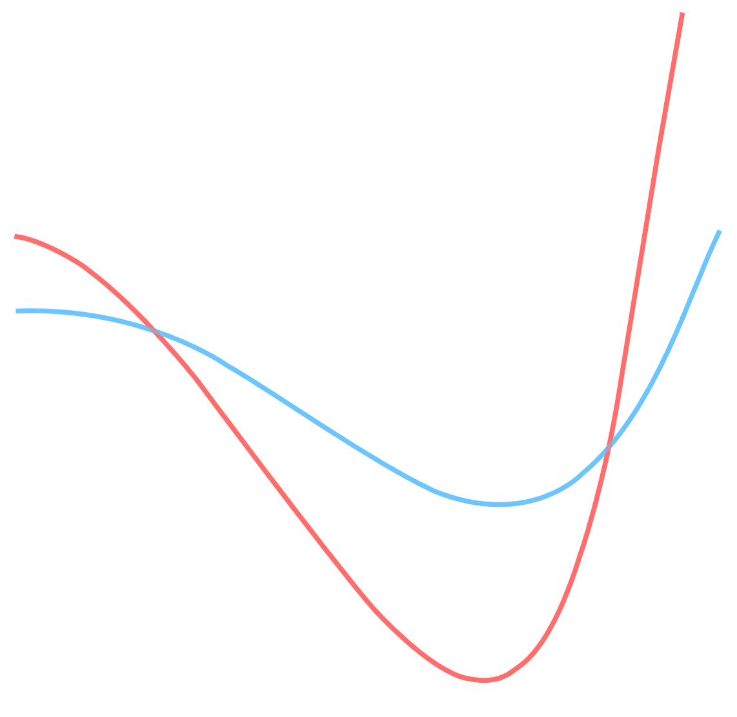
Brain Teaser - Bike Path
The diagram shows the tracks from a two wheeled bicycle. Was the bicycle traveling from left to right or right to left?

Slide 8
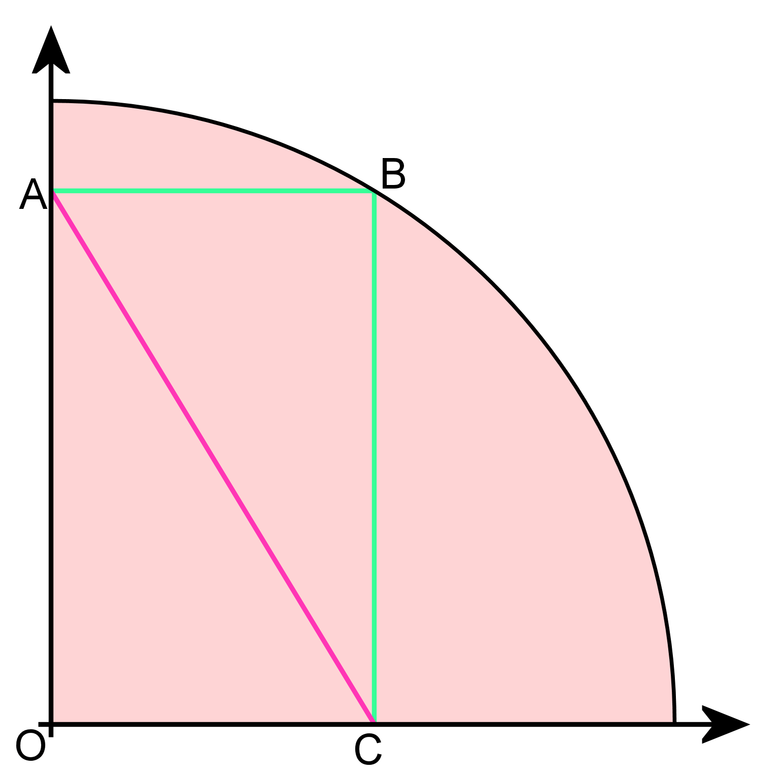
Brain Teaser - Circle
Examine the diagram carefully. It shows a quadrant of a circle radius 'r', with a rectangle touching the perimeter of the circle. What is the length of the line labeled A-C.

Slide 9
Project Discussion/Work Time
Notes:
Idea:
We’ll write the platform to make and conduct trading strategies.
You guys will write and implement the strategies, test them on prior data
Alternate for more software-oriented people you guys could also make the platform
We can do this in python/C++, if python use numPy and Yahoo Finance data
Use matplotlib plot graphs, show that in pdf/md/html file through github

Slide 10
Current Environment
As of right now, we’ll use Google Drive/Colab
.py files stored in the drive, need to be implemented
.ipynb file for driver, also needs to be implemented
Hoping to move to git/github and conda environments soon
Review the guide and setup your python and conda environments accordingly
If you get stuck, I will be available to help out next week outside of our normal meeting
Note: if you’re new to Python or need to brush up, check out
https://www.kaggle.com/learn/python

Slide 11
Calculating Variance and Sharpe of PnL
Variance
Given the list of trades, translate this into the raw PnL
Call .pct_change() on the pandas dataframe containing PnL to get returns
Call var() on the returns dataframe to get the variance of returns
Sharpe Ratio = E[Rp - Rf] / σ
Calculate portfolio returns (initial - final / initial)
Acquire Risk Free Rate (use 5% for now or acquire it from US Treasuries)
Adjust the RFR for the time period
Divide by the square root of the variance (standard deviation)

Slide 12
Attendance Form
This one
Link to Onboarding Document, Slack and Team Folder
https://tinyurl.com/2fk3aemj
https://docs.google.com/document/d/1oA2q-qjPCw1bY79zWf1LtpeN_da65L0ntnxzCQSsJRc/edit?usp=sharing

